Slide 1

Detecting COVID-19 with Chest X-Ray with Geo visualization of the Dataset

Slide 2
Project Guide: Mr. Rajesh Lomte Team Members: Rohit Naikade (TE COC 339) Mehul Lokhande (TE COC 331) Vijay Dabhade (TE COC 308) Govind Madankar (TE COC 332)
SDL Project
Department Of
Computer Engineering.
Academic Year:2020-21.
Semester:V

Slide 3
PROBLEM DEFINITION
Create an image classification model that can predict Chest X-Ray scans that belong to one of the three classes with a reasonably high accuracy.
Visualize the number of cases of covid-19 using different maps.

Slide 4
MOTIVATION.
Watching the huge impact of covid-19 on global level, it is time to design and develop some smart and effective solutions.
Medical staff and doctors have played a major role in tackling the pandemic.
In order to assist these Covid warriors, we have designed a machine learning model that helps classifying and identifying the respective condition of the patient.
This will provide consulting advice to doctors and help in speedy treatment.
For assisting administrative field, we are developing a dashboard which provides geo visualisation of the cases around different regions of the world.

Slide 5
OBJECTIVES.
Create an image classification model that can classify the Chest X-Ray scans into one of the 3 categories – Normal , Covid-19 or Viral Pneuomonia.
Classifying, will help predict the accurate disease or result.
Generate different visual maps like – Heat Map , Choropleth Map etc. with Circular Markers for better visuals.
Convert Jupyter notebook to dashboard.

Slide 6
Hardware and Software
Any OS which can support Jupyter NoteBook .
Anaconda or Jupyter Notebook Kaggle Kernel.
Python (any version above 3).
Browser.

Slide 7
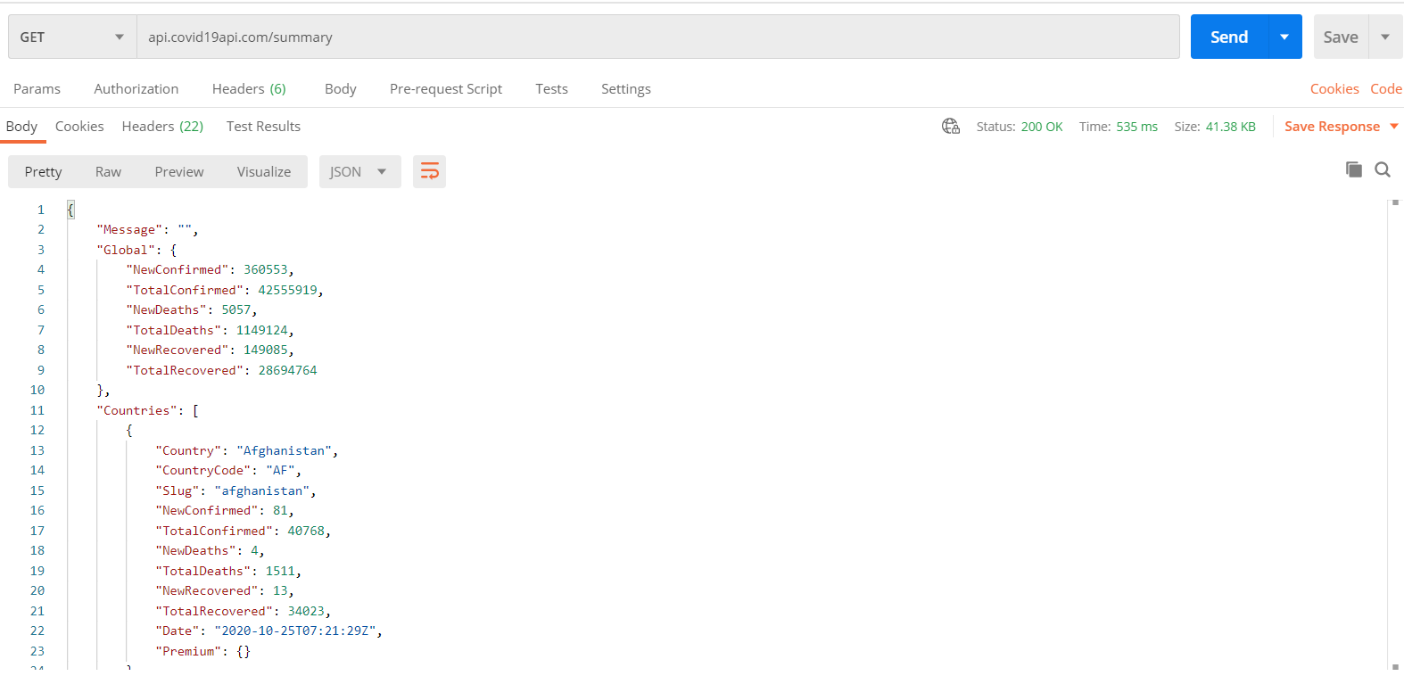
Dataset
API for Geo-visualisation : https://covid19api.com/
The JSON response recieve by the API GET request:

Slide 8
Dataset
Dataset for Classification :
https://www.kaggle.com/tawsifurrahman/covid19-radiography-database
Description of Dataset :
A database of chest X-ray images for COVID-19 positive cases along with Normal and Viral Pneumonia images.
There are 219 COVID-19 positive images, 1341 normal images and 1345 viral pneuomonia images.
This database if open source and researchers can use this database to produce useful and impactful scholarly work on COVID-19, which can help in tackling this pandemic.
Format of Dataset :
All the images are in Portable Network Graphics (PNG) file format and resolution is 1024*1024 pixels, which can be easily converted to 224*224 or 227*227 pixels typically required by the popular Convolutional Neural Networks (CNNs).

Slide 9
Libraries Used
numpy
pandas
torch
torchvision
random
folium
json
http.client

Slide 10
Theory
PART I : Image Classification Model
Create custom Dataset and DataLoader in PyTorch :
- This involves creating a custom Dataset and preparing a DataLoader in Pytorch.
Train a ResNet-18 model in PyTorch to perform Image Classification :
- ResNet-18 is a convolutional neural network that is 18 layers deep.
- It is a Pre-trained Model for PyTorch.
- Use a ResNet-18 model and train it on a COVID-19 Radiography dataset.

Slide 11
Theory (continued)
PART II : Geo visualization of the Dataset
Access data via an API by sending a GET request to the API.
Processing the received Data into a suitable JSON format.
Generate a Choropleth map , heat map etc. with Circular Markers :
- A Choropleth map has shaded or patterned regions corresponding to a statistical variable that represents an aggregate summary of a geographic characteristic within each area.
- A Heat map is a data visualization technique that shows magnitude of a phenomenon as two dimensional colors.
Convert Jupyter notebook to dashboard : This step generates a “.html” file , which provides a suitable dashboard.

Slide 12
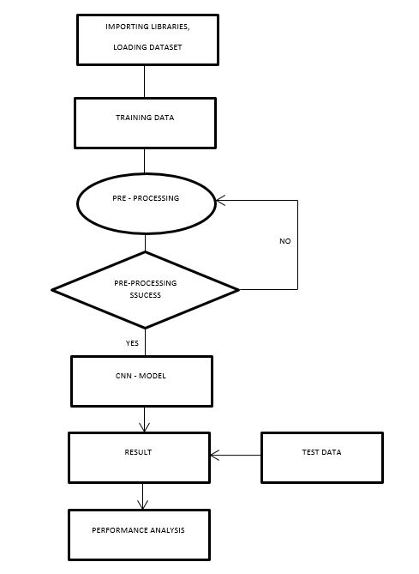
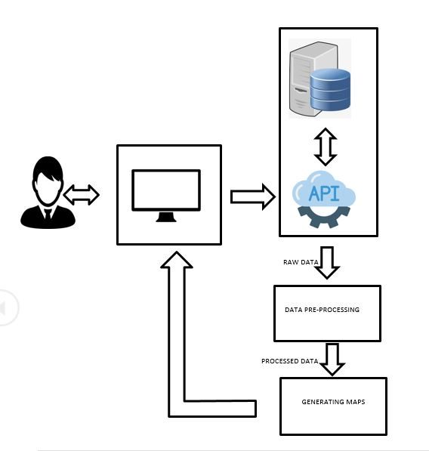
Archietecture Diagram.

Slide 13
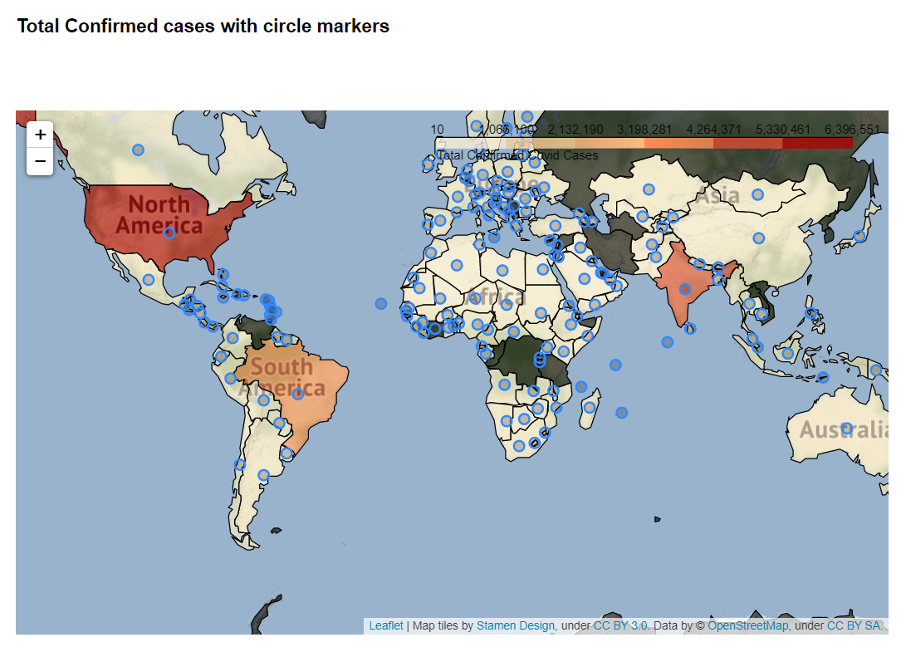
Implementation

Slide 14
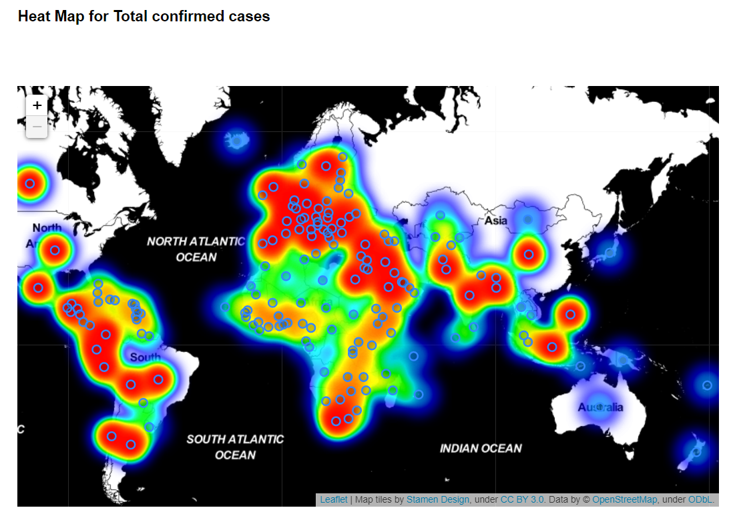
Implementation.

Slide 15
Applications and Conclusion
Thus this dashboard will help in easy geo visualisation of the cases around different regions of the world.
The machine learning model helps classifying and identifying the respective condition of the patient.
This will provide consulting advice to doctors and help in speedy treatment.

Slide 16
Suggestions?

Slide 17
THANK YOU.
Team Baltic Knights:
Rohit Naikade (339)
Mehul Lokhande (331)
Vijay Dabhade (308)
Govind Madankar (332)

